Slide 1
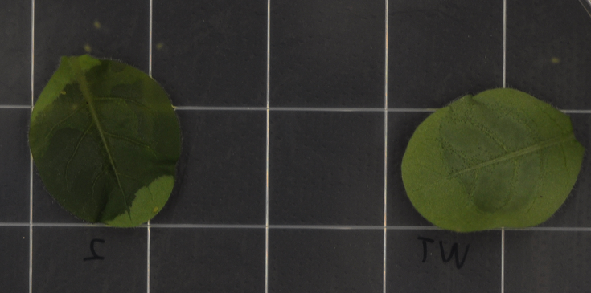
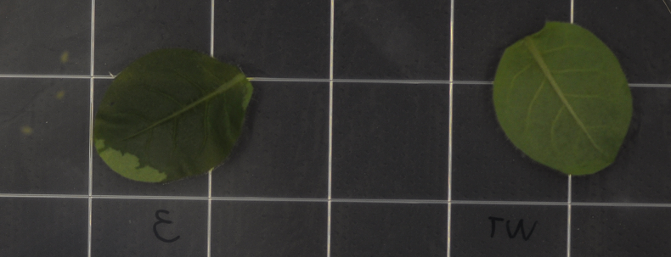
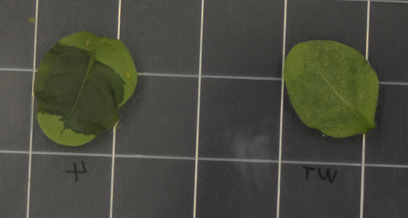
2
Mock
3
Mock
4
Mock
S6 Fig. Green peach aphids two-choice experiments on agar medium plates using santalene and bergamotene solutions: scale bar = 1 cm.

